Slide 1
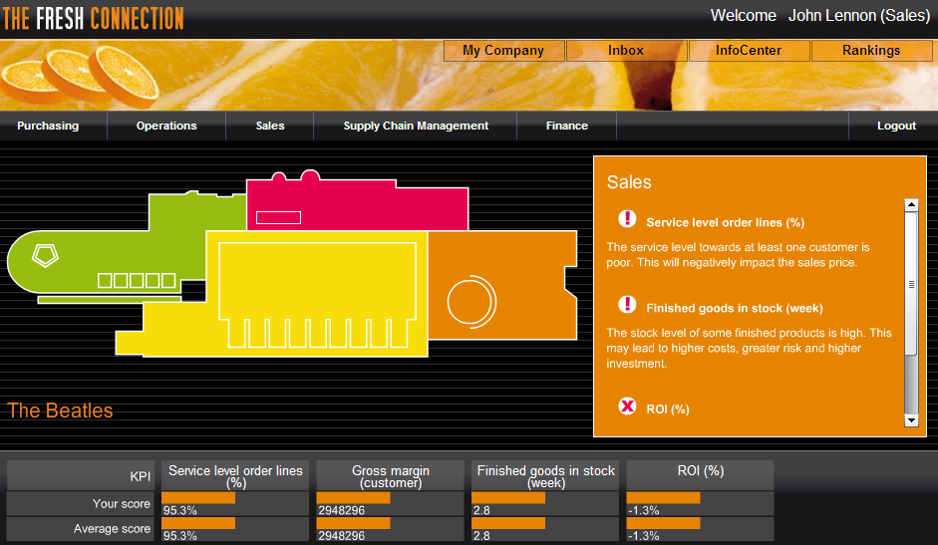
What is The Fresh Connection?
A learning experience built around a cross functional business simulation.

Slide 2
The Challenge
The Fresh Connection is a producer of fruit juices:
Suffering severe losses in the last year
Performing poorly across all functional areas
A new management team has been appointed:
VP of Sales
VP of Purchasing
VP of Supply Chain
VP of Operations
The assignment is to make the company profitable again:
Strategic choices such as low cost, best product, or market focus
Tactical choices such as customer contracts and supplier selection
Notes:
Poor performance:
1. Unhappy customers because we do not meet promised service levels
2. Inventories either too low or too high
3. Obsolescence
4. Production costs are too high
5. Questionable supplier selection.
A new management team has been appointed - that is you!
You need the make the company profitable again

Slide 3
Simulation and Reality
Real life experience within a simulated environment:
Success is not the responsibility of one function; it takes teamwork
A strategy is necessary to have a common direction
Internal and external collaboration is a key to success
The right management information is very important
The organization must be adaptable to changing situations
Decisions have a direct and big impact on profitability

Slide 4
The Supply Chain
VP Supply Chain
Components
Finished Product
Supply
Production
Distribution
VP Purchasing
VP Operations
VP Sales

Slide 5
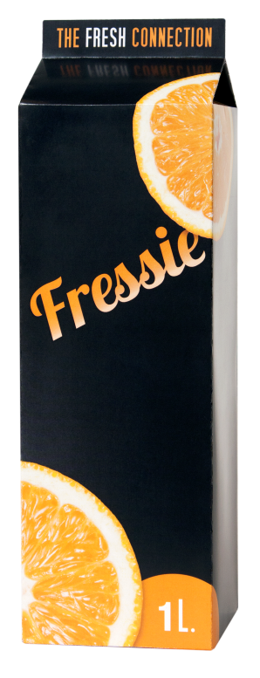
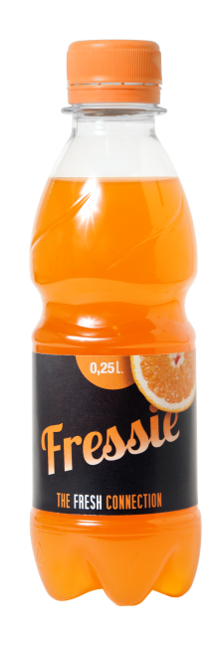
The Products
Two packaging types
1L carton
0.3L PET bottle
Three flavors
Orange
Orange C-Power
Orange/Mango
Shelf life of finished products is 20 weeks

Slide 6
The Theme
Creating alignment:
Between functional departments
Between strategy and execution
Between echelons in the supply chain

Slide 7
Key Topics
Business strategy
Functional trade-offs
Customer contracts
Investments
Supplier selection
Performance measurements
Risk management

Slide 8
Challenges
Communication
Decision making
Alignment
Consistency
Cooperation
Get out of the box and experiment
Learn and have some fun

Slide 9
Shelf life
Shelf life after packaging is 20 weeks
For example, if the shelf life agreement to customer is 75%, then the internal shelf life becomes 25%.
In other words, the customer is promised a remaining shelf life of 15 weeks at the moment of delivery.
Thus, any inventory older than 5 weeks may not be shipped and needs to be scrapped.
Internal portion
Customer portion

Slide 10
Individual Scores
Role | Performance Measure
Sales | Net revenue
Operations | Operational costs
Supply Chain | Inventory turns
Purchasing | Component cost

Slide 11
Overall Performance
Costs
Operational costs
Improvement projects
ROI
Revenue
Price and volume
Customer satisfaction
Portfolio
Investments
Working capital
Equipment & buildings

Slide 12
Logging In
The Fresh Connection
Login:
Password:
Let’s look around!

Slide 13
TFC Round 1

Slide 14
Report to Board of Directors
Results
What Worked
What Didn’t
Improvement Plans

Slide 15
Appendix

Slide 16
Print For Hybrid Binders
1-14
2 Slides
Print on Both Sides
Collated
Portrait Orientation
Pure Black and White

