Slide 1
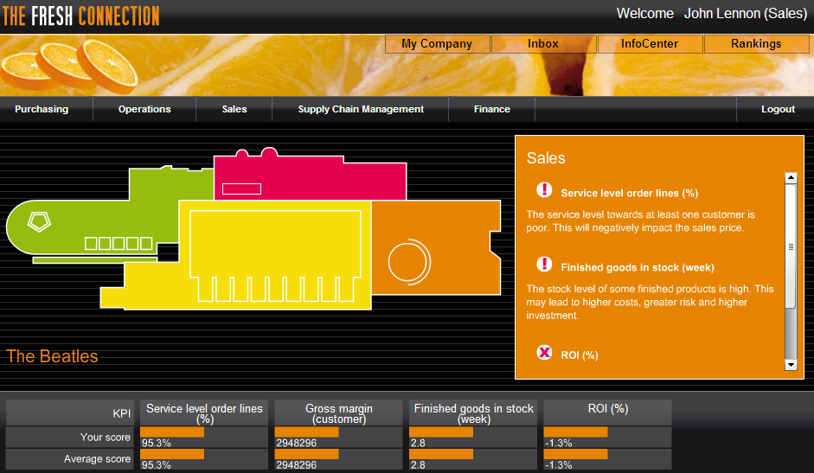
The Fresh Connection: Round 3
A learning experience built around a cross functional business simulation.

Slide 2
Questions on Shelf Life?
Shelf life after packaging is 20 weeks
For example, if the shelf life agreement to customer is 75%, then the internal shelf life becomes 25%.
In other words, the customer is promised a remaining shelf life of 15 weeks at the moment of delivery.
Thus, any inventory older than 5 weeks may not be shipped and needs to be scraped.
Internal portion
Customer portion

Slide 3
Questions on ROI?
Costs
Operational costs
Improvement projects
ROI
Revenue
Price and volume
Customer satisfaction
Portfolio
Investments
Working capital
Equipment & buildings

Slide 4
Questions on Supply Chain?
VP Supply Chain
Components
Finished Product
Supply
Production
Distribution
VP Purchasing
VP Operations
VP Sales

Slide 5
Questions on Products?
Two packaging types
1L carton
0.3L PET bottle
Three flavors
Orange
Orange C-Power
Orange/Mango
Shelf life of finished products is 20 weeks

Slide 6
Questions on Scores?
Role | Performance Measure
Sales | Net revenue
Operations | Operational costs
Supply Chain | Inventory turns
Purchasing | Component cost

Slide 7
Questions on Strategy?
Market Focus
Cost Leadership
Differentiation
Notes:
There are three basic business strategies from which you can choose to compete: cost leadership, differentiation, and market focus.
These three basic strategies have been developed and refined over many years by a number of management gurus.
One of them, Michael Porter, conducted extensive research and championed the use of these three strategies.
Most successful companies specialize in one strategy.
It may be possible to have different strategies for specific product lines, but the general conclusion from the research is that an organization should be focused on one of the three.
Let’s take a closer look at each one. As we go through them, think about where your organization is focused.

Slide 8
Collaborate as a Team
Integrated
Business
Planning
Business Review
Strategic Review
Portfolio Review
Demand Plan
Supply Plan
Financial Appraisal
Notes:
An emerging trend for organizations with solid S&OP processes is to “kick it up” a notch.
An advanced form of S&OP is known as “integrated business planning” or IBP.
This advancement integrates processes such as the business review, strategic review, and portfolio review into the standard S&OP planning cycle.

Slide 9
Logging In
The Fresh Connection
Login:
Password:
Let’s succeed!

Slide 10
TFC Round 3

Slide 11
Report to Board of Directors
Results
What Worked
What Didn’t
Improvement Plans

Slide 12
Appendix

Slide 13
Print For Hybrid Binders
1-11
2 Slides
Print on Both Sides
Collated
Pure Black and White

